Slide 1
Urinalysis
Reference: Laboratory Procedures for Veterinary Technicians 5th Ed. (Hendrix, Sirois)

Slide 2
Quality Assurance
Label samples immediately after collection and perform u/a as soon as possible.
Keep reagent strips and tablets in tightly sealed bottles; replace outdated reagents with fresh reagents.
Controls are available to verify strange results.
U/a report should include patient information, collection technique, date and time collected, method of preservation (if used) and complete results.

Slide 3
Specimen storage and handling
Analyze within 1 hour to avoid postcollection artifacts and degenerative changes.
If immediate analysis not possible, refrigerate for 6-12 hours max.
Allow refrigerated sample to come to room temp. prior to evaluation
Mix sample well to evenly distribute formed elements.

Slide 4
Specimen storage and handling
Samples allowed to stand at room temp. for long periods of time:
  Decreased glucose & bilirubin
  Increased pH
  Crystal formation
  Increased turbidity
  Breakdown of casts & RBCs
  Bacterial proliferation

Slide 5
When sending samples to outside lab
When sending sample to lab or if sample must be held for >12 hrs, you can add:
  1 drop of 40% formalin in 1 oz. of urine
  Toluene sufficient to form a layer on top of sample
  A single thymol crystal
  One part 5% phenol to 9 parts urine

Slide 6
Physical properties of urine
Include all observations made without the aid of microscope or chemical reagents
Volume, color, odor, transparency, and specific gravity (spG) of the urine are evaluated

Slide 7
Urine volume
May be affected by factors unrelated to disease:
  Fluid intake
  External losses
    Respiratory, intestinal tract
  Environmental temperature and humidity
  Amount and type of food
  Level of physical activity
  Size of animal
  species

Slide 8
Urine volume
Observing a single urination is not reliable for estimating urine output
Ideally determine 24-hour urine volume
Daily urine production varies in different domestic species
Normal daily output = 20-40 mg/kg (dogs and cats)
Terms:
  Polyuria, polydipsia, oliguria, anuria

Slide 9
Urine color
Normal urine = light yellow to amber
  Due to presence of urochromes
Magnitude of yellow color varies with degree of urine concentration or dilution
Colorless urine usually has low spG and may be associated with polyuria
Dark yellow to yellow-brown urine generally has high spG and may be associated with oliguria

Slide 10
Urine color
Yellow-brown, green, or greenish-yellow, foamy urine contains bile pigments
Red or red-brown urine indicates hematuria or hemoglobinuria
Brown urine may contain myoglobin
Some drugs may alter urine color
Evaluate urine for color in a clear plastic or glass container against a white background.

Slide 11
Clarity/transparency
In most species, freshly voided urine is transparent or clear
  Normal equine urine is cloudy; rabbit urine = milky
When observing urine for degree of transparency, place it against a letterprint background.
Transparency is noted as clear, slightly cloudy, cloudy, or turbid (flocculent)

Slide 12
Clarity/transparency
Urine may become cloudy while standing because of bacterial multiplication or crystal formation
Substances that cause urine to be cloudy include: RBCs, WBCs, epithelial cells, casts, crystals, mucus, fat, and bacteria
Other causes of turbidity can include contaminants from the collection container or surface and contamination with feces.

Slide 13
Odor
Normal urine has a distinctive odor that varies among species
Urine of male cats, goats, and pigs has a strong odor
An ammonia odor may occur with cystitis caused by bacteria that produce urease (Proteus spp. or Staphylococcus spp.)
Samples left standing at room temp. may develop an ammonia odor from bacterial growth

Slide 14
odor
A characteristic sweet or fruity odor to urine indicates ketones and is most commonly found with:
  Diabetes mellitus
  Ketosis in cows
  Pregnancy disease in sheep
    postparturent ketosis, eclampsia

Slide 15
Specific gravity
SpG = weight (density) of a quantity of liquid compared with that of an equal amount of distilled water.
Number and molecular weight of dissolved solutes determine SpG of urine.
SpG may be determined before or after centrifugation because the particles that settle during centrifugation have little or no effect on SpG.

Slide 16
Specific gravity
If urine is turbid, best to centrifuge and then use supernatent to determine SpG.
SpG of normal urine = variable; depends on:
  Eating and drinking habits
  Environmental temperature
  Time of sample collection
Early morning, mid-urination sample tends to be most concentrated.

Slide 17
Specific gravity
Interpretation of urine spG yields information on hydration status and the ability of the kidneys to concentrate or dilute urine.
Most commonly determined by refractometer
Reagent strips = least reliable method
Normal ranges:
  Dog = 1.001 – 1.060 (1.025)
  Cat = 1.001 – 1.080 (1.030)

Slide 18
Specific gravity
Increased spG is seen with decreased water intake, increased fluid loss through sources other than urination (e.g. sweating, panting, diarrhea), and increased excretion of urine solutes.
Decreased spG is seen in diseases in which the kidneys cannot resorb water and with increased fluid intake, such as polydipsia or excessive fluid administration.

Slide 19
Chemical properties
Testing for various chemical constituents of urine is performed with reagent strips impregnated with appropriate chemicals or reagent tablets.
Be aware of expiration dates
Some reagent strips test for numerous constituents simultaneously; others exist for individual tests
Urine is added to reagent strip via pipette or the strips are dipped in the urine sample and color changes are noted at specific intervals.

Slide 20
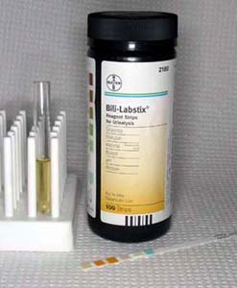
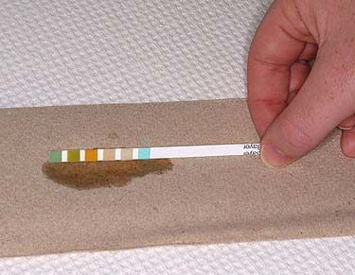
Reagent strips

Slide 21
pH
pH is a measure of hydrogen ion concentration
Above 7.0 = alkaline; below 7.0 = acidic
Normal pH (dog and cat) = 6-7
If too acidic or too alkaline, specific crystals or uroliths can form
pH of samples left standing open at room temp. tends to increase from loss of CO₂
  Delays in reading reaction may lead to color changes and false readings

Slide 22
pH
pH of a healthy animal’s urine depends largely on diet.
Alkaline urine usually found in animals on plant diets; high-protein cereal diets or diets of animal origin cause acidic urine.
Herbivores normally have alkaline urine; carnivores acidic urine; omnivores either acidic or alkaline depending on what was ingested.

Slide 23
Protein
Usually absent or present only in trace amounts in normal urine obtained by catherization or cystocentesis
Voided samples or those obtained by expressing the bladder may contain small amount of protein resulting from secretions that may contaminate urine during its passage along the urinary tract.

Slide 24
protein
Trauma to urinary tract from cystocentesis, catheterization, or bladder expression may cause sufficient bleeding to cause a trace of protein in the urine.
Protein levels in urine can be measured by reagent test strips, sulfosalicyclic acid turbidity test, and urine protein/creatine ratio (UPC).

Slide 25
Protein
Reagent strips (dipsticks) measure protein by progressive color changes on the reaction pad.
  Primarily detect albumin
  False positive results may occur in alkaline urine depending on diet, urinary tract infection, or urine retention (urethral obstruction)
UPC ratio can help confirm significant amounts of protein in urine
  Sample is centrifuged and supernatent is used
  Ratio is obtained by dividing protein concentration by creatinine concentration

Slide 26
protein
Very dilute urine can yield false-negative because the concentration may be below the sensitivity of the testing method.
Transient proteinuria may result from a temporary increase in glomerular permeability, allowing excessive protein to enter filtrate
  May be found with muscle exertion, emotional stress, or convulsions
  Occasionally a small amount of urine protein is found after parturition, during the first few days of life, and during estrus.

Slide 27
protein
In most cases, proteinuria indicates disease of urinary tract, especially the kidneys
Multiple myeloma, a cancer of plasma cells, may produce large quantities of protein
Proteinuria of renal origin may be caused by trauma, tumors, renal infarcts, or necrosis from drugs and chemicals such as sulfonamides, lead, mercury, arsenic, and ether
Inflammation of the urinary or genital tract may cause proteinuria (also with traumatic catheterization or bladder expression)

Slide 28
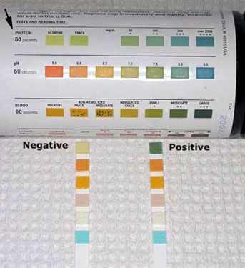
Proteinuria

Slide 29
Glucose
Presence of glucose in urine is known as glucosuria or glycosuria
Glucose is filtered through the glomerulus and resorbed by the kidney tubules
Glucosuria usually does not occur in normal animals unless the blood glucose level exceeds the renal threshold

Slide 30
glucose
A high-carbohydrate meal may lead to blood glucose levels exceeding the renal threshold.
Fear, excitement, or restraint, especially in cats, often causes hyperglycemia and glucosuria as a result of epinephrine release.
Glucosuria often occurs after IV administration of fluids containing glucose and occasionally after general anesthesia.

Slide 31
glucose
False-positive results for glucose may be seen after use of various drugs, including Vitamin C (abscorbic acid), morphine, aspirin, cephalosporins, and penicillin.
Tablet glucose tests usually detect any sugar in the urine.
Most reagent strips detect only glucose.

Slide 32
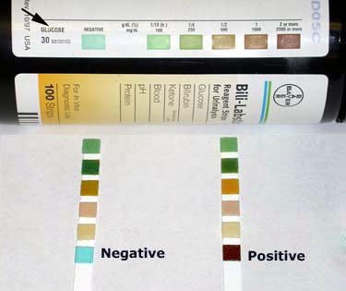
Glucosuria

Slide 33
Ketones
Ketones include acetone, acetoacetic acid, and beta-hydroxybutyric acid.
Ketones are important sources of energy and are normally produced during fat metabolism.
Conditions characterized by altered metabolism may result in an excessive amount of fat catabolism to provide energy.
Ketonuria frequently occurs in animals with diabetes mellitus.

Slide 34
Ketones
Problems develop when excessive ketones are produced.
Ketones are toxic, causing CNS depression and acidosis.
Acidosis resulting from ketonemia is ketoacidosis.
Ketonemia with ketonuria also occurs with high-fat diets, starvation, fasting, long-term anorexia, and impaired liver function.

Slide 35
bile pigments
Bile pigments commonly detected in urine are bilirubin and urobilinogen.
Normal dogs, especially males, occasionally have bilirubin in urine because of low renal threshold for conjugated bilirubin and ability of their kidneys to conjugate bilirubin.
Bilirubin in cats, horses, pigs, or sheep is considered abnormal and suggests disease.

Slide 36
Bilirubin
Bilirubinuria is seen in a number of diseases, including obstruction of bile flow from the liver to the small intestine and in liver disease.
Hemolytic anemia may also cause bilirubinuria, especially in dogs.
False-negative results occur if urine is exposed to sunlight or artificial light.

Slide 37
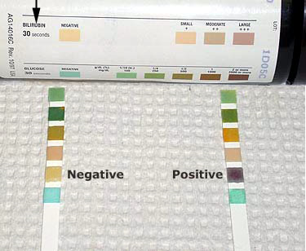
Bilirubinuria

Slide 38
urobilinogen
In the intestines, bacteria convert bilirubin to stercobilinogen and urobilinogen.
Most is excreted in feces
A small amount is excreted by kidneys into the urine.
Urobilinogen in a urine sample is considered normal.
Reliability of screening tests is questionable because of instability of urobilinogen

Slide 39
urobilinogen
Increased values
  excessive RBC breakdown
  increased urobilinogen production
  re-absorption - a large hematoma
  liver dysfunction
  hepatic infection
  poisoning
Low values
  failure of bile production
  obstruction of bile passage

Slide 40
Nitrite
The nitrite portion of the dipstick analysis has limited value in veterinary medicine. This is due to the high number of false negative test results in small animals.
Nitrites occur in urine during some bacterial infections. In order to achieve an accurate positive test result, the urine must have been retained in the bladder at least 4 hours.
A positive test indicates a bacterial infection. Gram negative rods are more likely produce a positive test response.
Negative test results do not exclude infection. The urinary tract infection may involve organisms that do not convert nitrites, or the urine may not have been held in the bladder greater than 4 hours.

Slide 41
Blood
Tests for blood in urine detect hematuria, hemoglobinuria, and myoglobinuria
Hemoglobinuria is usually a sign of disease causing bleeding somewhere in the urogenital tract.
Ghost cells (shells of lysed RBCs) may be seen if the source of hemoglobin in lysis of RBCs.
Moderate to large amounts of blood impart a cloudy red, brown, or wine color to urine
Similar colors, but with a transparent appearance that remains after centrifugation, indicate hemoglobinuria.

Slide 42
blood
Hemoglobinuria is usually caused by intravascular hemolysis.
If urine is very dilute or very alkaline, hemoblobinuria can originate from lysis of RBCs in the urine after excretion.

Slide 43
Blood
Urine containing myoglobin is usually very dark brown to almost black.
Severe muscle damage causes myoglobin to leak from muscle cells into the blood.
Distinguishing myoglobinuria from hemoglobinuria can be difficult.
History and clinical signs suggesting muscle damage help to differentiate.

Slide 44
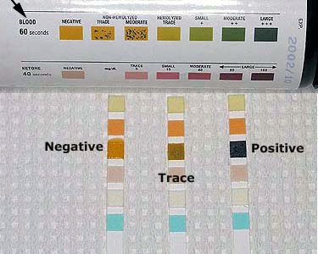
Hematuria

Slide 45
leukocytes
Presumptive evidence of WBCs in urine may be obtained with reagent strips.
Designed to detect leukocyte esterase
  Present in all WBCs except lymphocytes
Many false-negative reactions occur
  Especially dogs
  Glucosuria, elevated SpG, certain antibiotics (tetracyclines)
False-positive reactions occur with cats
  Old samples, fecal contamination
    Microscopic evaluation necessary to confirm a positive result

Slide 46
Microscopic examination
Microscopic examination of urine sediment is an important part of a complete u/a, especially for recognizing diseases of the urinary tract.
With the exception of horse and rabbit urine, normal urine of domestic animals does not contain a large amount of sediment.

Slide 47
Microscopic examination
Examine sediment while urine is fresh because bacteria will multiply if allowed to stand at room temp. for a long period of time.
Urine collected via cystocentesis is best for microscopic exam
Sediment may be examined stained or unstained
  Stains often introduce artifacts into the sediment, particularly precipitate material and bacteria.

Slide 48
Constituents of urine sediment
Erythrocytes
Leukocytes
Epithelial cells
Casts
Crystals
Microorganisms, parasites, ova
Miscellaneous
  Mucus threads, spermatoza, fat droplets, other artifacts

Slide 49
erythrocytes
May have several different appearances depending on urine concentration, pH, and time elapsed between collection and examination
In a fresh sample, RBCs are small, round, usually smooth edged, somewhat refractile, and yellow or orange
  May be colorless if hemoglobin has diffused during standing
In concentrated urine, RBCs may shrink and crenate
In dilute or alkaline urine, RBCs swell and may lyse
  Lysed RBCs may appear as colorless rings (shadow or ghost cells) and vary in size.

Slide 50
leukocytes
Spherical and can appear as a dull gray or greenish-yellow
Identified in sediment by their characteristic granules or lobulations of the nucleus
Few are found in urine of animals without urinary or genital tract disease
WBCs shrink in concentrated urine and swell in dilute urine
Finding >2-3 per HPF indicates an inflammatory process somewhere in urinary or genital tracts
Pyuria = excessive WBCs in the urine

Slide 51
Epithelial cells
A few epithelial cells in urine are considered normal and occur from normal sloughing of old cells.
Three types of epithelial cells are found in urinary sediment: squamous, transitional, and renal.

Slide 52
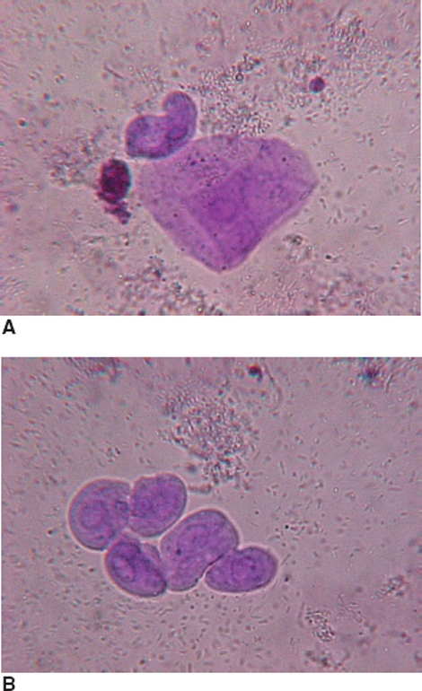
Epithelial Cells
A. Squamous epithelial cells
  Derived from the distal urethra, vagina, vulva, or prepuce
  Presence = not significant
B. Transitional epithelial cells
  Derived from the bladder, ureters, renal pelvis, and proximal urethra
  Increased numbers suggest cystitis or pyelonephritis
  Also may be seen with catheterization

Slide 53
renal cells
Smallest epithelial cells observed in urine
Originate in the renal tubules and are only slightly larger than WBCs
Generally round and contain a large nucleus and nongranular or finely granular cytoplasm
Increased numbers occur in diseases of kidney parenchyma

Slide 54
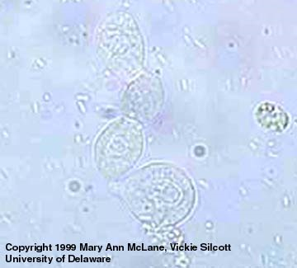
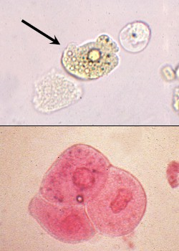
Renal Epithelial cells

Slide 55
casts
In the renal tubules, secreted protein precipitates in acidic conditions and forms casts shaped like the tubules in which they form.
Commonly classified on the basis of appearance as hyaline, epithelial, cellular (RBCs and/or WBCs), granular, waxy, fatty, and mixed
Type depends in part on how quickly the filtrate is moving through the tubules and how much tubular damage is present

Slide 56
casts
All are cylindrical structures with parallel sides; width is determined by width of the lumen in which they are formed.
Any cells or structures in the area may also be incorporated into casts, imparting the morphologic features that allow them to be identified
Dissolve in alkaline urine (make sure sample has not become alkaline from standing too long)
May be disrupted with high-speed centrifugation and rough sample handing

Slide 57
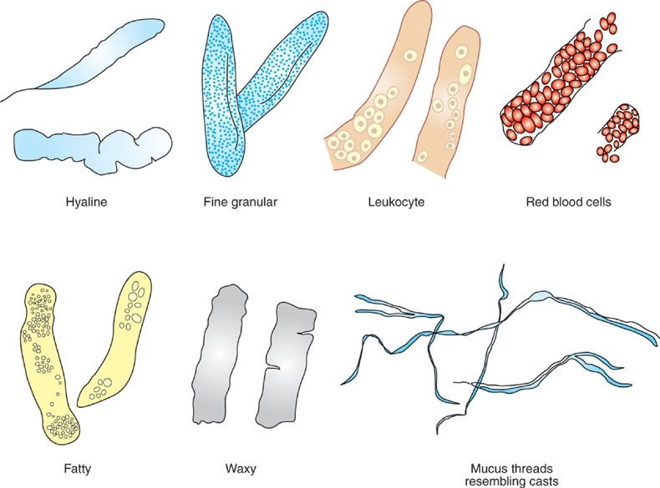
casts

Slide 58
Hyaline casts are clear, colorless and sometimes transparent. They are composed only of protein. Hyaline casts seen can indicate the mildest form of renal irritation but can also be seen with fever, poor renal perfusion, strenuous exercise or general anesthesia.

Slide 59
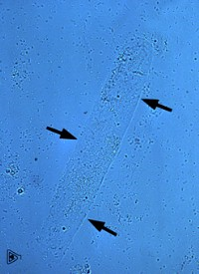
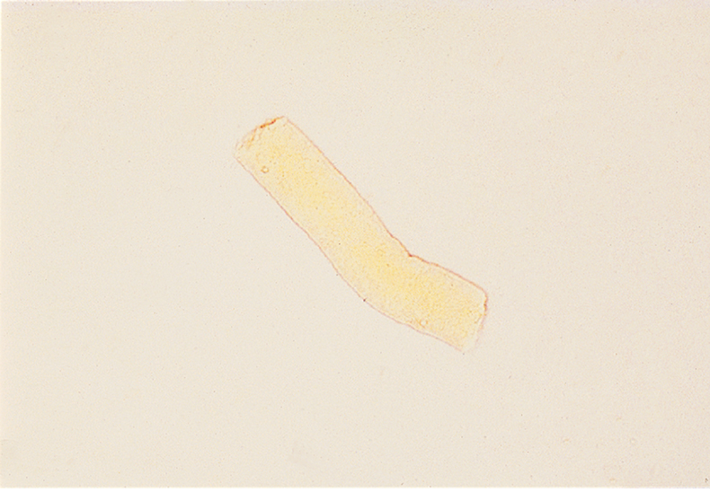
Hyaline casts

Slide 60
Granular casts are hyline casts that contain granules. These are the most common type of casts see in animals. The granules are from epithilial cells, RBC, or WBC that become incorporated and then degenerated. Granular casts are seen in cases of acute nephritis.

Slide 61
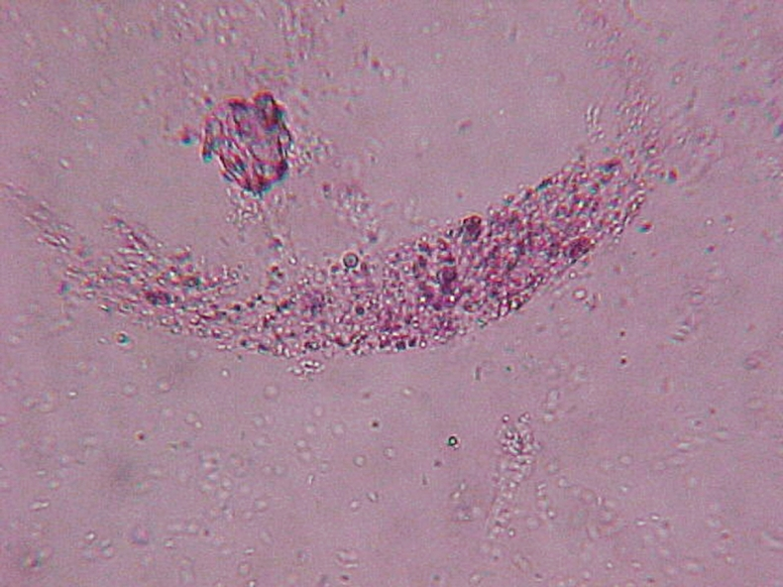
Granular cast

Slide 62
epithelial casts most commonly result when disease processes such as ischemia, infarction, or nephrotoxicity cause degeneration and necrosis of tubular epithelial cells.
A common scenario is the patient with severe dehydration. The resulting casts are flushed out of the tubules in urine produced following rehydration with fluid therapy.

Slide 63
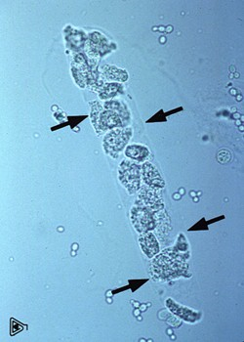
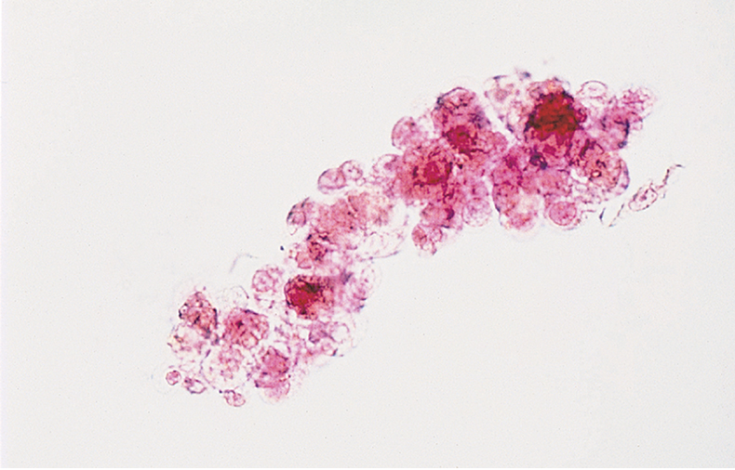
Epithelial casts

Slide 64
Leukocytes casts contain white blood cells, predominantly segmented neutrophils. The presence of white blood cells and leukocyte casts indicates inflammation in the renal tubules.

Slide 65
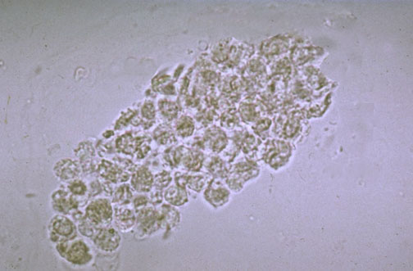
Leukocyte cast

Slide 66
Erythrocyte casts are deep yellow to orange in color. These casts form when red blood cells aggregate within the lumen of the tubule. Erythrocyte casts indicate renal bleeding. The bleeding may be from hemorrhage due to trauma or bleeding disorders or as part of an inflammatory response.

Slide 67
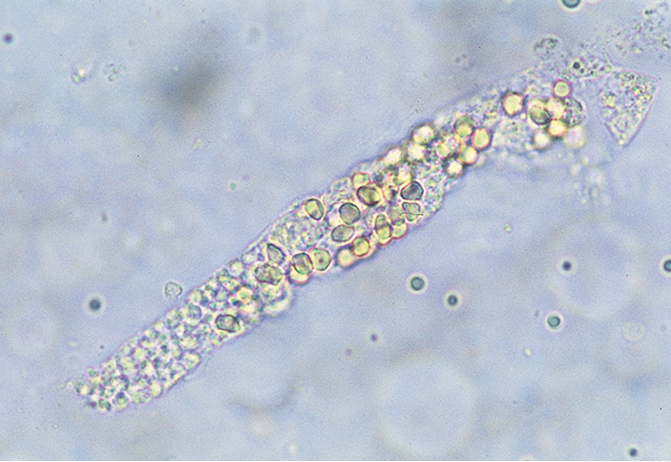
erythrocyte cast

Slide 68
Waxy casts resemble hyaline casts but are usually wider with square ends rather than round. They also have a waxy appearance. These casts are colorless or gray and are highly refractile. These casts indicate severe or chronic degeneration of the tubules.

Slide 69
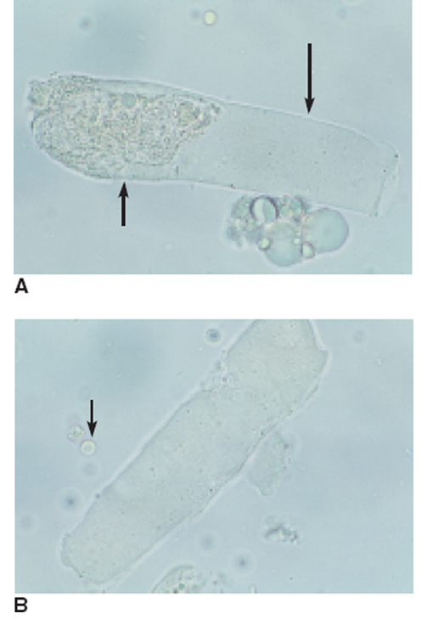
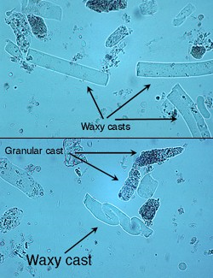
Waxy casts

Slide 70
Fatty casts contain droplets of fat that appear as refractile bodies. These casts are commonly seen in cats with renal disease. They are also occasionally seen in diabetic dogs.

Slide 71
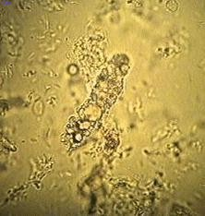
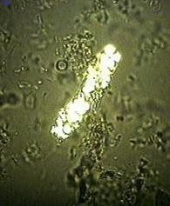
Fatty casts

Slide 72
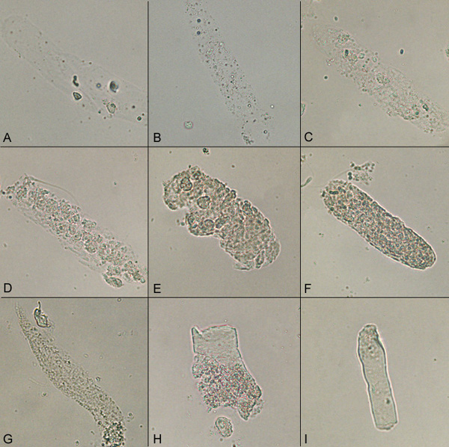
A: Hyaline cast; B: Fatty cast; C: Hyaline to finely granular cast;
D: Cellular cast; E: Cellular to coarsely granular cast;
F: Coarsely granular cast; G: Finely granular cast;
H: Granular to waxy cast, I: Waxy cast.

Slide 73
crystals
Presence in urine is called crystalluria
Crystalluria may or may not be of clinical significance.
Certain crystals form as a consequence of their elements being secreted into the urine by normal renal activity or as a consequence of metabolic diseases
Type of crystals formed depends on urine pH, concentration and temperature, and solubility of elements

Slide 74
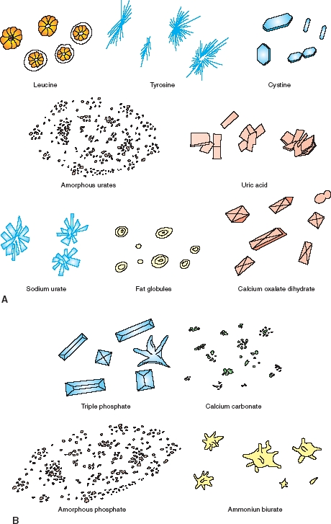

Slide 75
crystals
Crystals are generally reported as occasional, moderate, or many
Although crystals and uroliths are often identified based on morphologic characteristics, the only definitive methods to identify crystals are x-ray diffraction and chemical analysis.

Slide 76
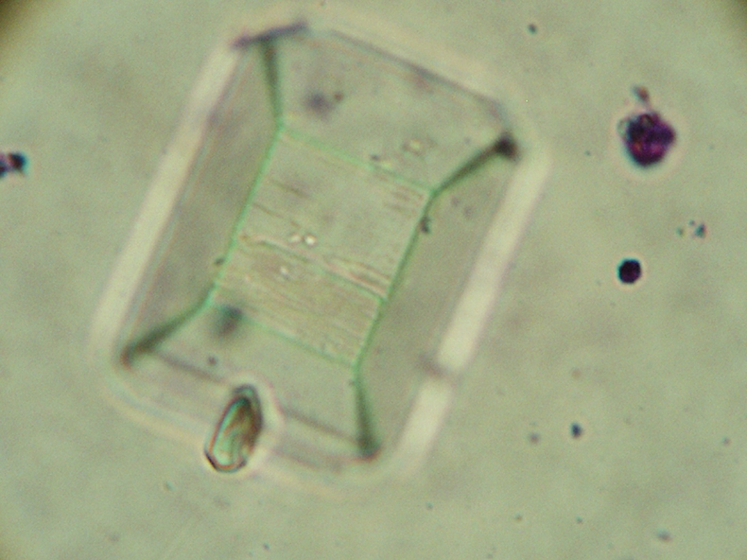
Struvite crystals
Typically resemble coffin lids or prisms; may take other shapes
Sometimes referred to as:
  Triple phosphate crystals
  Magnesium ammonium phosphate crystals
6 to 8 sides = typical
Found in alkaline to slightly acidic urine.

Slide 77
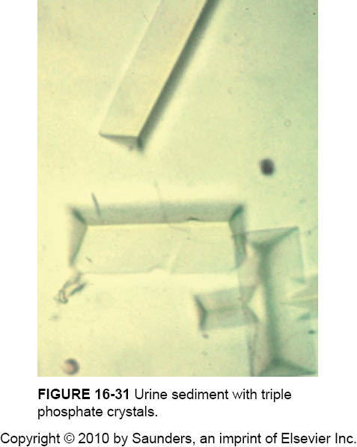
Struvite crystals
The most common type of crystals (dogs and cats)
Often seen in urine from clinically normal individuals.
Urinary tract infection with urease-positive bacteria can promote struvite crystalluria (and urolithiasis) by raising urine pH and increasing free ammonia.

Slide 78
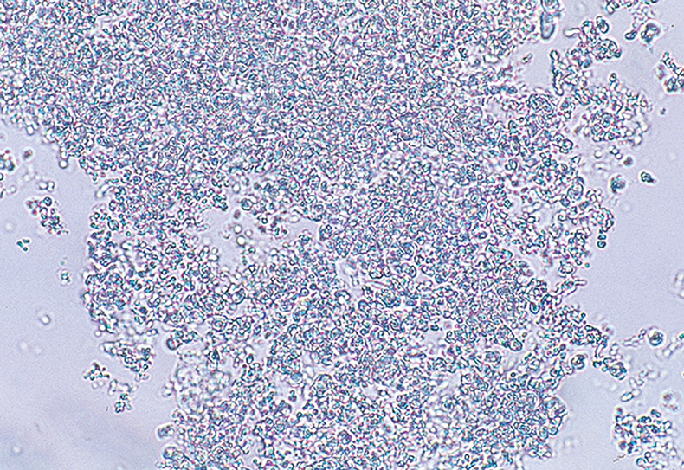
Amorphous phosphate crystals
Common in alkaline urine and appear as a granular precipitate.
Similar in appearance to amorphous urate crystals; however, amorphous phosphate crystals lack color.

Slide 79
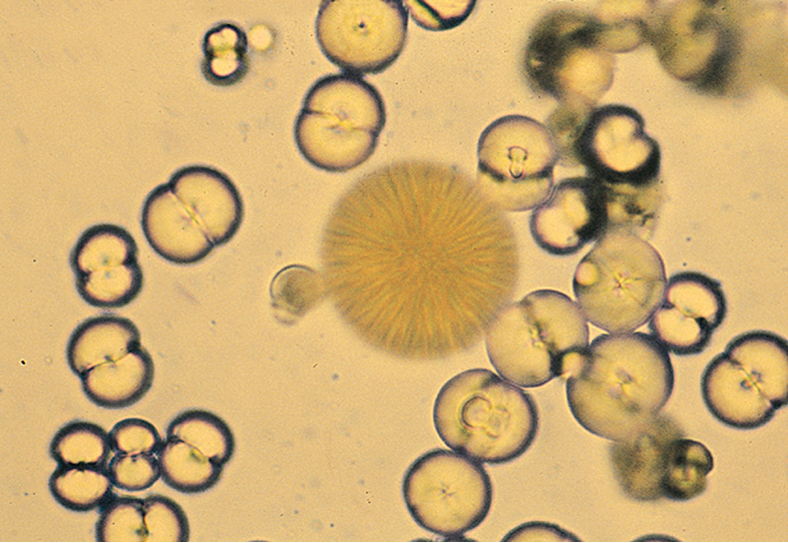
Calcium carbonate crystals
Common in healthy horses and rabbits
Round with many lines radiating from the centers or can appear as large granular masses.
Also may have a “dumbbell” shape
Neutral to alkaline urine

Slide 80
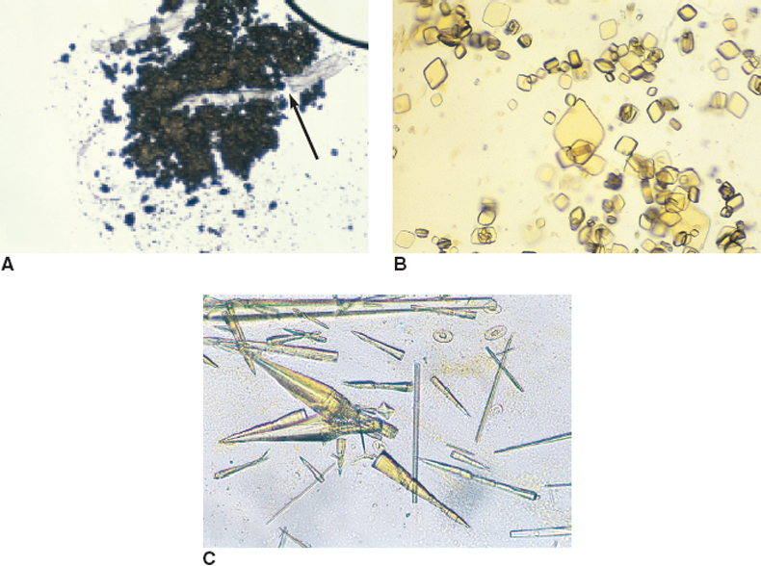
Urate and uric acid crystals
Figure 5-27 A, Amorphous urate crystals. A cotton fiber (contaminant) is trapped within the crystals (arrow). B, Uric acid crystals. These are not commonly found in small animals except for dalmatian dogs. C, Sodium urate crystals. May be found in association with ammonium biurate uroliths. A calcium oxalate dihyrate crystals is also present (center).
(From Raskin RE, Meyer DJ: Atlas of canine and feline cytology, St Louis, 2001, Saunders.)

Slide 81
Urate and uric acid crystals
Amorphous urates (Na, K, Mg, or Ca salts) tend to form in acidic urine, and may have a yellow or yellow-brown color.
Uric acid crystals commonly occur in dalmatians and bulldogs due to their body’s inability to process purines (from certain types of meat).
Formation is favored in acidic urine.

Slide 82
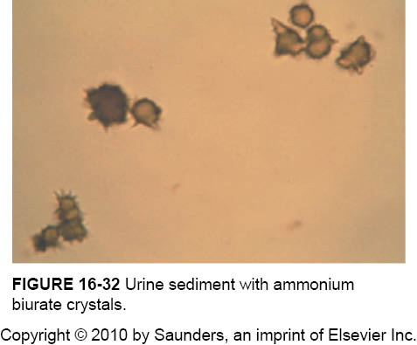
Ammonium biurate crystals
Ammonium urate (or biurate) crystals generally appear as brown or yellow-brown spherical bodies with irregular protrusions ("thorn-apples").
Formation is favored in neutral to alkaline urine.
Both Dalmatians and Bulldogs are predisposed to urate urolithiasis. They are rarely, if ever, seen in urine from normal cats or dogs of other breeds.

Slide 83
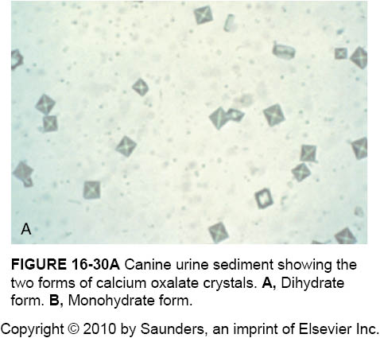
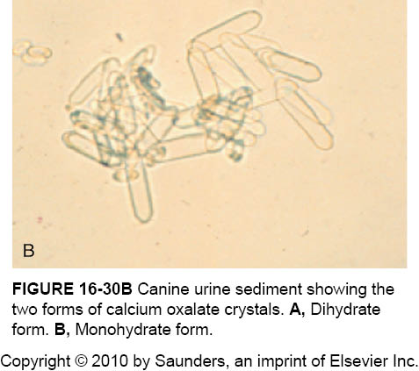
Calcium oxalate crystals
Calcium oxalate dihydrate
Calcium oxalate monohydrate

Slide 84
Calcium oxalate crystals are formed in acidic and neutral urine and may be seen in small numbers normally in dogs.
The urine of animals poisoned with ethylene glycol often contains large numbers of the monohydrate crystals.

Slide 85
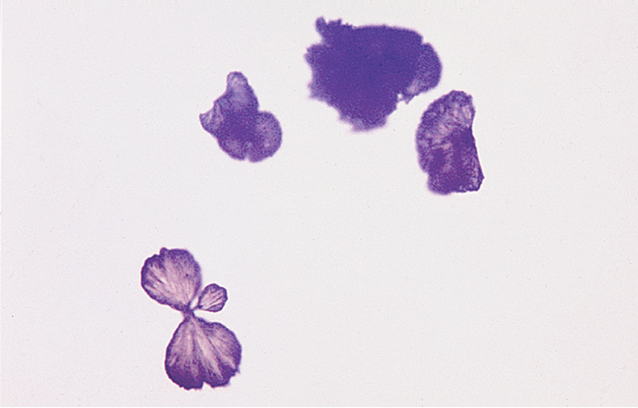
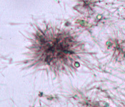
Tyrosine crystals
Dark, needle-like projections; highly refractile; often found in small clusters
Not commonly seen in dogs/cats
Associated with liver disease
Form in acidic urine.

Slide 86
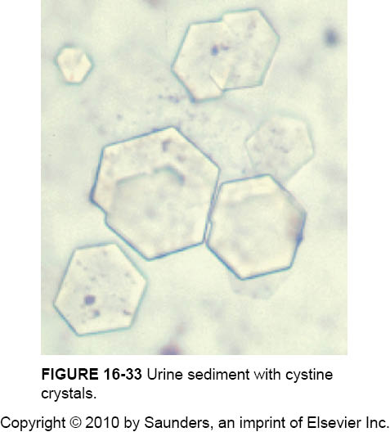
Cystine crystals
Form in acidic urine.
Often aggregate in layers
Presence may be an indication of cystinuria, an inborn error of metabolism involving defective renal tubular reabsorption of certain amino acids including cystine. Sex-linked inheritance is suspected since male dogs are almost exclusively affected. Many breeds, as well as mongrels, have been reported affected . Renal function otherwise appears to be normal and, aside from a tendency to form uroliths, the defect is without serious consequence.

Slide 87
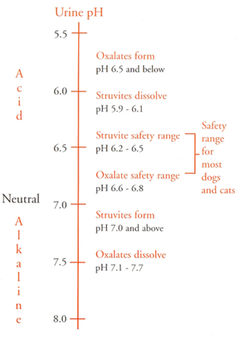
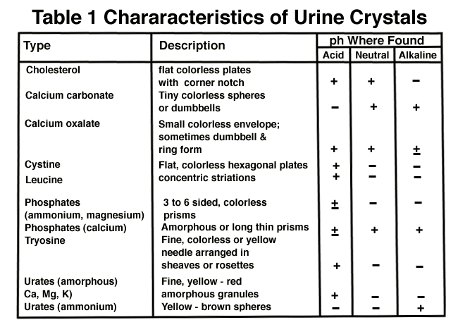
Optimal pH for crystal formation

Slide 88
Microorganisms, parasites, ova
A variety of microorganisms can be found in urine sediment, including bacteria, fungi, and protozoa.
Normal urine collected by cystocentesis or catheterization does not normally contain bacteria and is considered sterile.
Bacteria can be identified only under high magnification
  May be round (cocci) or rod shaped (bacilli), usually refract light, and appear to be quivering as a result fo Brownian movement.
  Are reported as few, moderate, many, or tntc

Slide 89
bacteria
A large number of bacteria accompanied by a large number of WBCs suggests infection and inflammation of the urinary tract (e.g. cystitis, pyelonephritis) or genital tract (e.g. prostatitis, metritis, vaginitis).
Bacteria in the urine sample are most significant when also identified within the cytoplasm of the WBCs.
  Submit samples for bacterial culture & sensitivity testing.

Slide 90
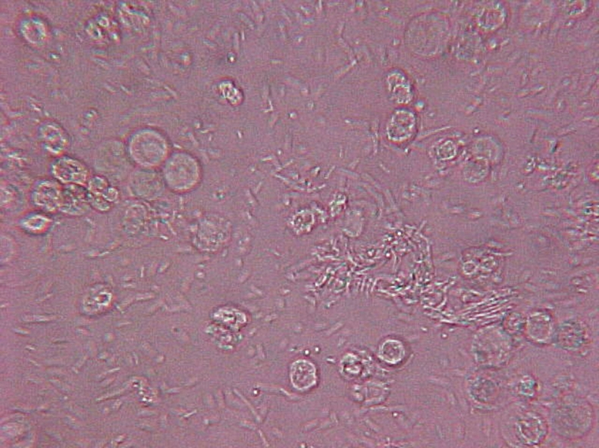
WBCs and Bacteria in urine

Slide 91
Yeast, fungi
Yeast are often confused with RBCs or lipid droplets but usually display characteristic budding.
  Usually contaminants in urine because yeast infeciton of the urinary tract are rare in cats/dogs.
Other fungi may be found (filamentous and usually branching)

Slide 92
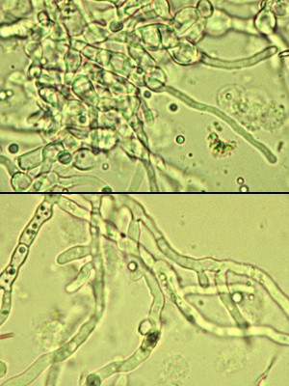
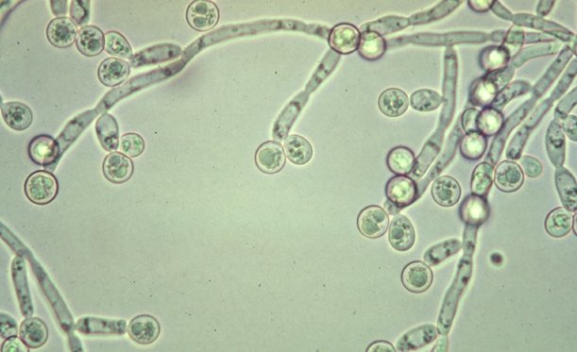
Yeast & other fungi

Slide 93
Ova & Parasites
Parasite ova may be seen in urine sediment of animals with urinary parasites or because of fecal contamination at the time of sample collection.
Parasites of the urinary tract include: Capillaria plica and Dioctophyma renale.
Microfilaria of Dirofilaria immitis may be seen in urine sediment of dogs with circulating microfilaria if hemorrhage into the urine occurs from disease or trauma during collection.

Slide 94
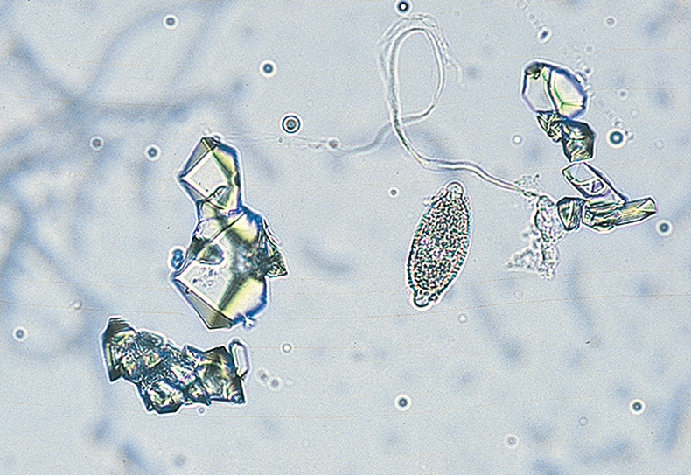
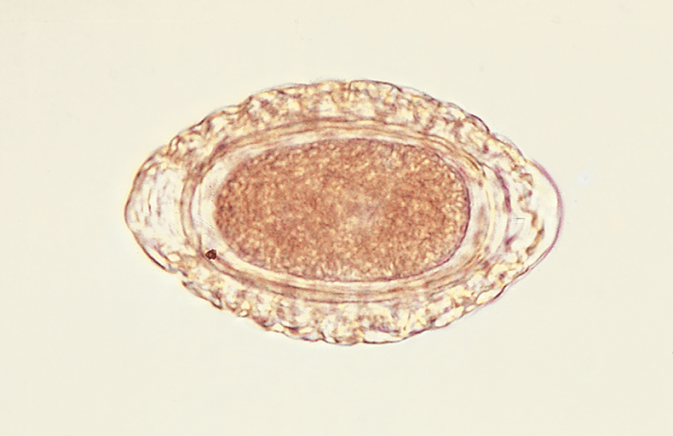
Urinary Parasite ova
Capillaria plica
Dioctophyma renale

Slide 95
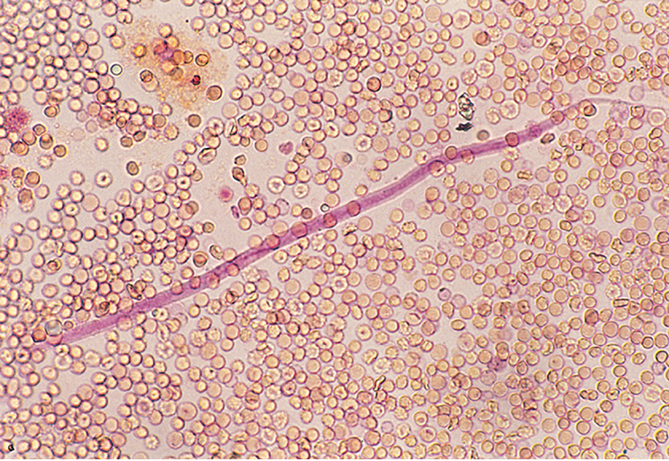
Dirofilaria immitis

Slide 96
Miscellaneous components of urine
Mucus threads are often confused with casts but do not have well-delineated edges of casts.
  Normal in equine urine (horses have mucus glands in renal pelvis and ureter)
  In other animals indicates urethral irritation or contamination of sample with genital secretions.
Spermatoza occasionally seen in sediment of intact male or recently bred females.
Fat droplets appear as lightly green-tinged, highly refractile, spherical bodies of varying sizes.
  Catheter lubricants, oily surfaces of collection vials or pipettes
  Fat in urine = lipuria; seen to some degree in cats

Slide 97
Other artifacts
Artifacts may enter the urine sample during collection, transportation, or examination
  Air bubbles, oil droplets, starch granules (glove powder), hair, fecal material, plant spores, pollen, cotton fiber, dust, glass particles or chips, bacteria, and fungi may contaminate urine.
  Ova of intestinal parasites may be observed as a result of fecal contamination.

